Slide 1
Chapter 14
Web Database Programming Using PHP

Slide 2
Chapter 14 Outline
A Simple PHP Example
Overview of Basic Features of PHP
Overview of PHP Database Programming

Slide 3
Web Database
Programming Using PHP
Techniques for programming dynamic features into Web
PHP
  Open source scripting language
  Interpreters provided free of charge
  Available on most computer platforms

Slide 4
A Simple PHP Example
PHP
  Open source general-purpose scripting language
  Comes installed with the UNIX operating system

Slide 5
A Simple PHP Example (cont’d.)
DBMS
  Bottom-tier database server
PHP
  Middle-tier Web server
HTML
  Client tier

Slide 6
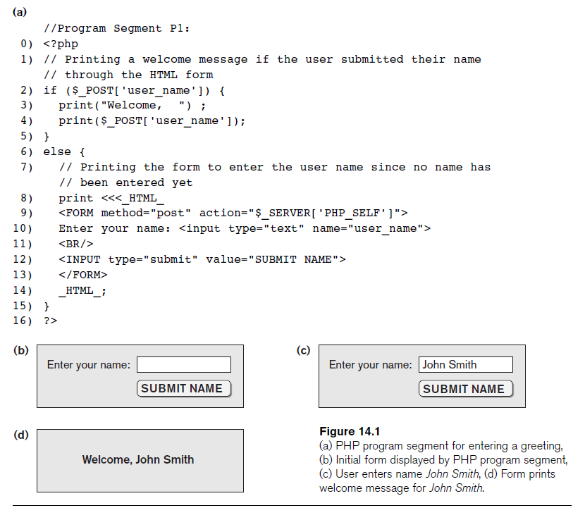

Slide 7
A Simple PHP Example (cont’d.)
Example Figure 14.1(a)
PHP script stored in:
  http://www.myserver.com/example/greeting.php
<?php
  PHP start tag
?>
  PHP end tag
Comments: // or /* */

Slide 8
A Simple PHP Example (cont’d.)
$_POST
  Auto-global predefined PHP variable
  Array that holds all the values entered through form parameters
Arrays are dynamic
Long text strings
  Between opening <<<_HTML_ and closing _HTML_;

Slide 9
A Simple PHP Example (cont’d.)
PHP variable names
  Start with $ sign

Slide 10
Overview of Basic Features of PHP
Illustrate features of PHP suited for creating dynamic Web pages that contain database access commands

Slide 11
PHP Variables, Data Types, and Programming Constructs
PHP variable names
  Start with $ symbol
  Can include characters, letters, and underscore character (_)
Main ways to express strings and text
  Single-quoted strings
  Double-quoted strings
  Here documents
  Single and double quotes

Slide 12
PHP Variables, Data Types, and Programming Constructs (cont’d.)
  Period (.) symbol
  String concatenate operator
Single-quoted strings
  Literal strings that contain no PHP program variables
Double-quoted strings and here documents
  Values from variables need to be interpolated into string

Slide 13
PHP Variables, Data Types, and Programming Constructs (cont’d.)
Numeric data types
  Integers and floating points
Programming language constructs
  For-loops, while-loops, and conditional if-statements
Boolean expressions

Slide 14
PHP Variables, Data Types, and Programming Constructs (cont’d.)
Comparison operators
  == (equal), != (not equal), > (greater than), >= (greater than or equal), < (less than), and <= (less than or equal)

Slide 15
PHP Arrays
Database query results
  Two-dimensional arrays
  First dimension representing rows of a table
  Second dimension representing columns (attributes) within a row
Main types of arrays:
  Numeric and associative

Slide 16
PHP Arrays (cont’d.)
Numeric array
  Associates a numeric index with each element in the array
  Indexes are integer numbers
    Start at zero
    Grow incrementally
Associative array
  Provides pairs of (key => value) elements

Slide 17
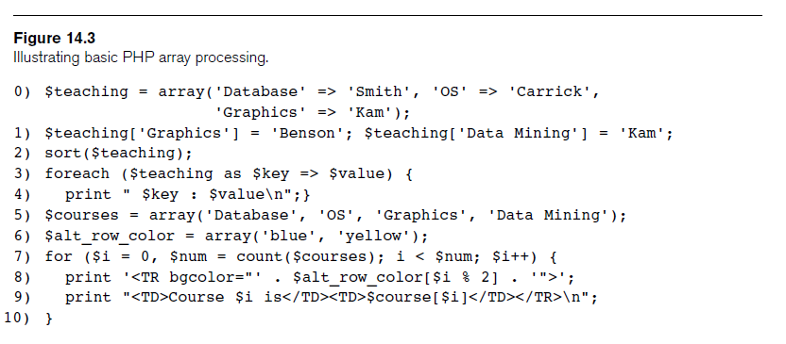
PHP Arrays (cont’d.)

Slide 18
PHP Arrays (cont’d.)
Techniques for looping through arrays in PHP
Count function
  Returns current number of elements in array
Sort function
  Sorts array based on element values in it

Slide 19
PHP Functions
Functions
  Define to structure a complex program and to share common sections of code
  Arguments passed by value
Examples to illustrate basic PHP functions
  Figure 14.4
  Figure 14.5

Slide 20
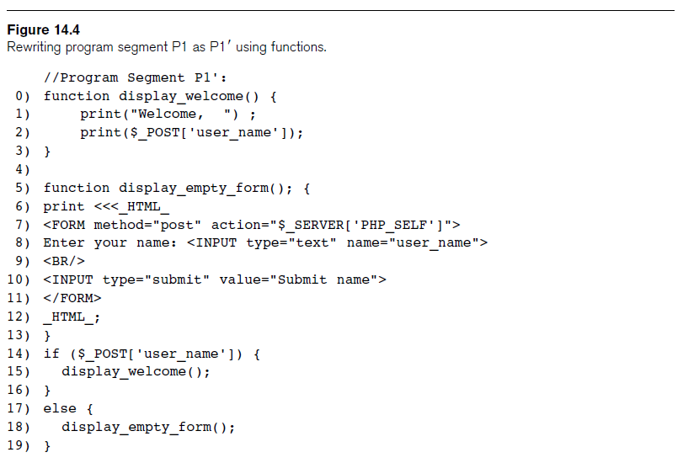

Slide 21
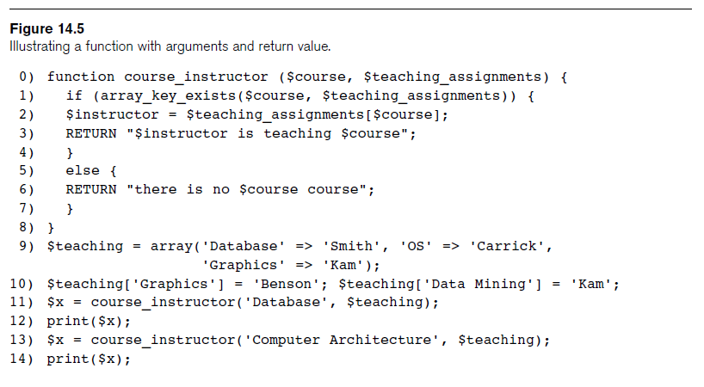
PHP Functions (cont’d.)

Slide 22
PHP Server Variables and Forms
Built-in entries
  $_SERVER auto-global built-in array variable
  Provides useful information about server where the PHP interpreter is running

Slide 23
PHP Server Variables and Forms (cont’d.)
  Examples:
    $_SERVER['SERVER_NAME']
    $_SERVER['REMOTE_ADDRESS']
    $_SERVER['REMOTE_HOST']
    $_SERVER['PATH_INFO']
    $_SERVER['QUERY_STRING']
    $_SERVER['DOCUMENT_ROOT']
$_POST
  Provides input values submitted by the user through HTML forms specified in <INPUT> tag

Slide 24
Overview of PHP Database Programming
PEAR DB library
  Part of PHP Extension and Application Repository (PEAR)
  Provides functions for database access

Slide 25
Connecting to a Database
Library module DB.php must be loaded
DB library functions accessed using DB::<function_name>
DB::connect('string')
  Function for connecting to a database
  Format for 'string' is: <DBMS software>://<user account>:<password>@<database server>

Slide 26
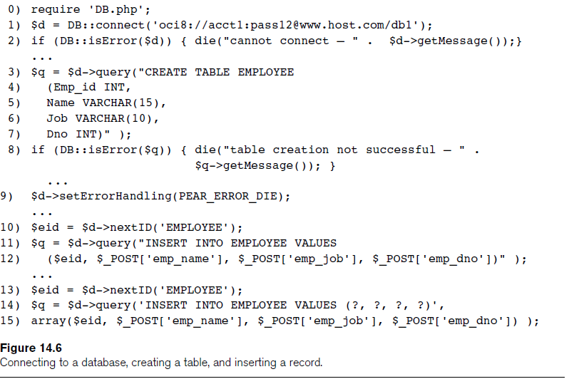

Slide 27
Connecting to a Database (cont’d.)
Query function
  $d->query takes an SQL command as its string argument
  Sends query to database server for execution
$d–>setErrorHandling(PEAR_ERROR_DIE)
  Terminate program and print default error messages if any subsequent errors occur

Slide 28
Collecting Data from Forms and Inserting Records
Collect information through HTML or other types of Web forms
Create unique record identifier for each new record inserted into the database
PHP has a function $d–>nextID to create a sequence of unique values for a particular table
Placeholders
  Specified by ? symbol

Slide 29
Retrieval Queries from Database Tables
$q
  Query result
  $q->fetchRow() retrieve next record in query result and control loop
$d=>getAll
  Holds all the records in a query result in a single variable called $allresult

Slide 30
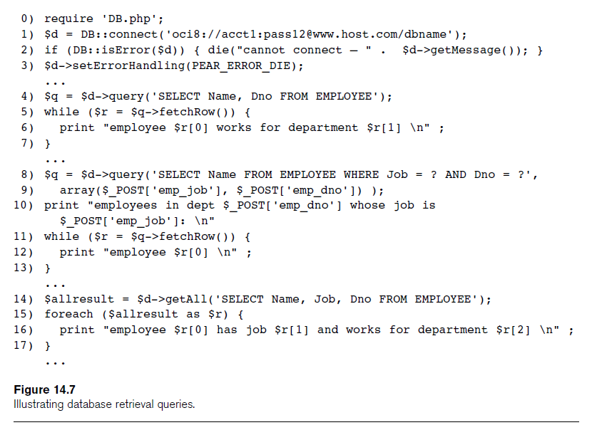

Slide 31
Summary
PHP scripting language
  Very popular for Web database programming
PHP basics for Web programming
Data types
Database commands include:
  Creating tables, inserting new records, and retrieving database records

